Slide 1
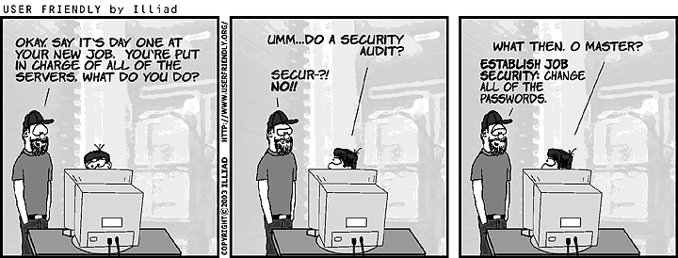
INFO3068 Secure Computing
Course Introduction – Part 1
Hit F5 to play the slideshow
Notes:
Revised for Fall 2020 online delivery.

Slide 2

Professor
Mohammed Ali
mali@fanshawec.ca
Western University Graduate in Software Engineering
Software Engineering in the banking sector

Slide 3
Week 1 Objectives
Introduction
Course Information Sheet
Course Plan
Key Concepts
This course presents security concepts from a software developer’s perspective

Slide 4
Course Resources
FanshaweOnline
XAMPP (no virtual machine this time)
In this course, we'll use PHP as a learning tool
How are web applications constructed?
What do we need to watch out for?

Slide 5
Evaluation
Midterm and Final Tests 40%
Projects and Labs 60%
Some small exercises, programming assignments

Slide 6
Course Objectives
Understand the common threats, exploits
Develop software that is more threat-resistant (“build security in”)
Understand securing information through
Confidentiality (encryption)
Integrity (digital signatures)
Authenticity (digital certificates)
Access (passwords and permissions)
Disaster and Event Recovery

Slide 7
Concepts

Slide 8
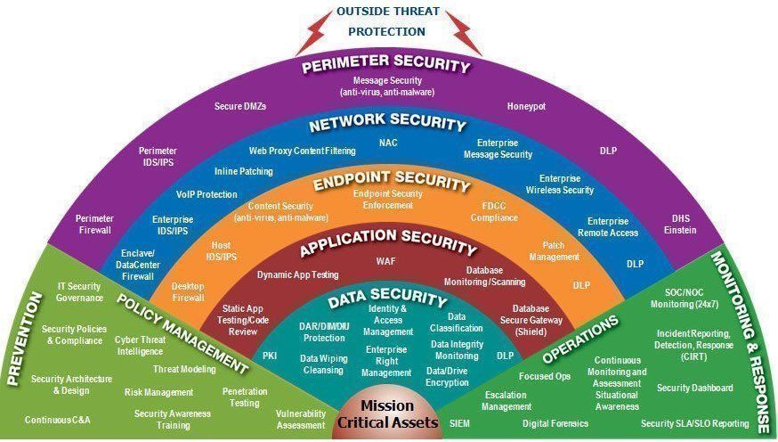
Concept: Defense in Depth
Michael Fisher https://blog.knowbe4.com/great-defense-in-depth-infographic
Notes:
https://en.wikipedia.org/wiki/Defense_in_depth_(computing)
CIA: confidentiality, integrity and availability

Slide 9
Concepts
Defense in depth
Why might this not work as well as it used to?
Layers of security controls
Controls can be physical, technical, or administrative
Notes:
https://en.wikipedia.org/wiki/Defense_in_depth_(computing)
CIA: confidentiality, integrity and availability

Slide 10
Concepts
CIA
Confidentiality
How sensitive is the information and prevent it reaching the wrong people
Integrity
Assurance that data is not altered or destroyed in an unauthorized manner
Availability
Continuous operation of computing systems (e.g. prevent Denial Of Service attacks)
Notes:
https://en.wikipedia.org/wiki/Defense_in_depth_(computing)
CIA: confidentiality, integrity and availability

Slide 11
Concepts
Personal data (names, addresses, phone numbers, Social Insurance Numbers, etc.)
Financial data (credit card numbers, bank account details)
Health records (sensitive medical information)
Intellectual property (source code, trade secrets, R&D)
Information Monetization
Examples of information that has value?
How has the value of information changed behaviour of business? Of hackers?
Identity Theft
https://haveibeenpwned.com/
Notes:
https://en.wikipedia.org/wiki/Defense_in_depth_(computing)
CIA: confidentiality, integrity and availability

Slide 12
Common Terms
Bug: A general flaw in code that causes unintended behavior. Usually accidental and discovered during testing.
Defect: A broader term used in quality assurance; a mismatch between expected and actual results. A bug is a type of defect.
Weakness: A flaw that may not break functionality but introduces security risks (e.g., poor input validation). Weaknesses can be exploited to create vulnerabilities.
Bug
Defect
Weakness
Any distinction between these terms?
Is it possible for software to be "bug free?"

Slide 13
Common Terms
Exploit
According to avast.com an exploit is any attack that takes advantage of vulnerabilities in applications, networks, or hardware
Observation: new exploits tend to be variations of common past exploits

Slide 14
Common Terms
Legal & Ethical: Security professionals hired to test and strengthen systems.
Illegal & Unethical: Break into systems for personal gain, profit, revenge, or disruption.
Legally questionable, ethically mixed: May find vulnerabilities without permission and disclose them (sometimes responsibly, sometimes not).
Hacker (White, Black, or Grey Hat)
Intruder
Cracker
What are the distinctions?
Consider legal behavior versus ethical behavior

Slide 15
Common Terms
Spammer
Is all spam malicious?
Why is this activity worthwhile for the spammer?

Slide 16
Common Terms
Developers and security teams can check their software stack against known vulnerabilities, apply patches, or implement mitigations quickly.
NVD
National Vulnerability Database
Common Vulnerabilities and Exposures (CVE)
How can this help us?
Can we be proactive?
Yes, Being proactive means regularly patching, monitoring vendor advisories, and training staff to recognize risks before exploits spread widely.

Slide 17
Common Terms
Data Loss Prevention (DLP)
Software designed to detect data leaks or breaches
Intrusion Detection /Prevention System (IDS/IPS)
Located behind the firewall on protected network
Detect and log abnormal traffic based on programmed signatures (data pattern)
Response capability based on signature = IPS

Slide 18
Common Terms
Insider threats (malicious employees already inside the network). Social engineering attacks (e.g., phishing).
Malware delivered via allowed protocols (e.g., a malicious PDF through email).
Weak or stolen user credentials (firewalls don’t validate user identity).
Firewall
Device (implemented in software or hardware) at network perimeter which will filter out traffic as programmed by administrator
What does a firewall not protect against?
Web Content Filtering
Originally used for stopping people from getting to specific websites or limiting inappropriate content getting to children
Now often used to block malware

Slide 19
Common Terms
Blacklist: Blocks known malicious domains, IPs, or software. Useful for stopping common threats quickly
Whitelist: Allows only approved domains, applications, or users. Useful in high-security environments where only trusted traffic should pass.
Blacklist
Whitelist
How can these be useful?
Limitations? How do hackers get around these?
Blacklists: Hackers constantly change IPs, domains, and use obfuscation techniques.
Whitelists: Hackers may compromise whitelisted applications or trick admins into adding them. Supply-chain attacks (e.g., SolarWinds) are a real-world example.
Blacklists can’t keep up with the ever-changing pool of malicious sites/actors.
Whitelists are restrictive and can block legitimate traffic, making them harder to maintain.

Slide 20
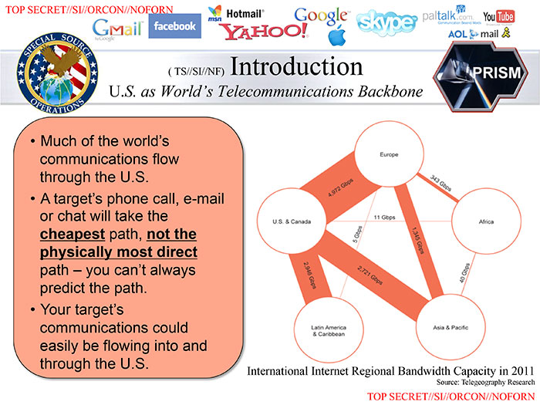
Security vs. Privacy?
Notes:
One of the slides leaked by Edward Snowden

Slide 21
Hacker / Intruder Goals
Reconnaissance
Scanning: determine assets on a network, services on a server
Fingerprinting, determine OS and software
Enumerating a network
Exploit
Steal and use information
Destroy information
Stop or slow down access
Extortion

Slide 22
Hacker Motivation
Profit
Use or sell stolen identities, information
Revenge
Terminated employees
Rejected candidates
Political motivation
Challenge
Test company, government
Prove superior skill
Vandalism
Web site defaced

Slide 23
End of Part 1

Slide 25
References
www.cert.org
www.us-cert.gov
www.sans.org
www.securityspace.com
www.wikipedia.org
www.userfriendly.org

